Slide 1
Refactoring with React

Slide 2

Pretest
What is state?
What is inverse data flow? What is a pure function?
How to test events and functions with Jest?

Slide 3
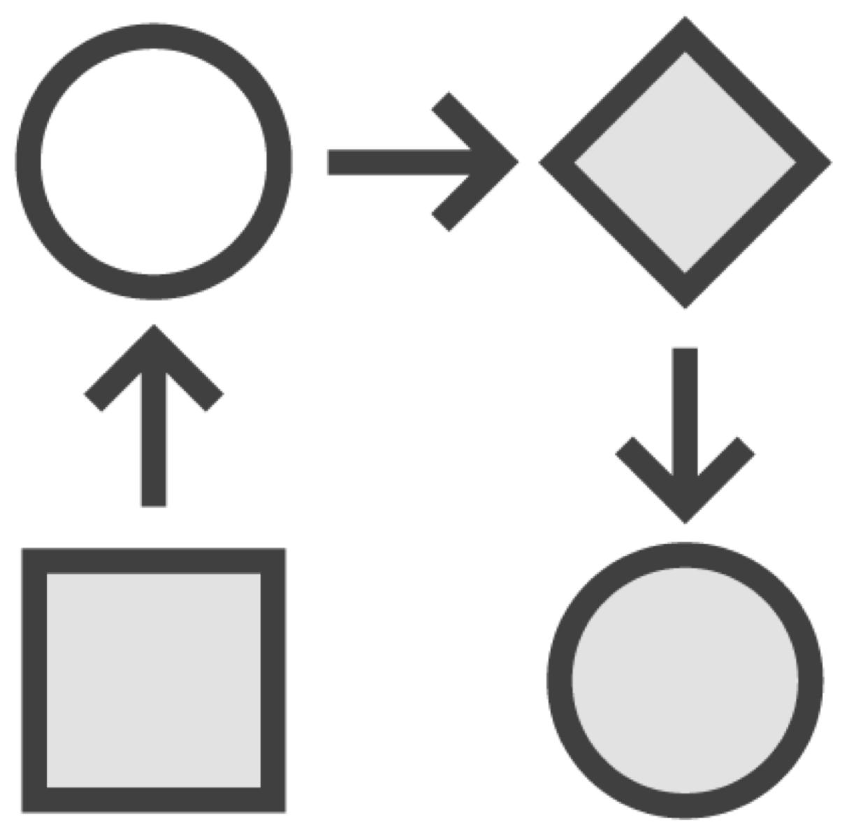
React Development Process
Create a Component Hierarchy
Build a Static Version Identify the Minimal UI State
Identify Where State Should Live Add Inverse Data Flow

Slide 4
Types of Data in React
Props
Is passed from parent to child
Is immutable
State
Is modified using setState()
Calling setState() triggers re-render State updates may be asynchronous

Slide 5
Minimal UI State
Is it not passed in from a parent?
Does it change over time?
Is it not possible to compute based on other state or props?

Slide 6
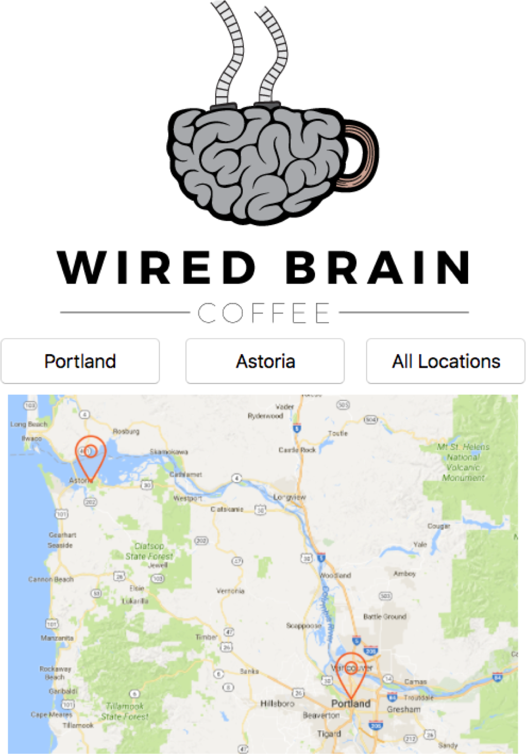
What’s Our State?
Button Name?
No, it’s passed as a prop
Map Name?
No, it’s computed
Currently Displayed Map!
Yes! It changes based on user input

Slide 7
Where Should the State Live?
Identify every component that renders something based on the state
Button, Map
Find a common owner (or parent)
StoreLocator

Slide 8


Inverse Data Flow
React uses one-way data binding
Make data flow explicit Update state using callbacks
Events

Slide 9
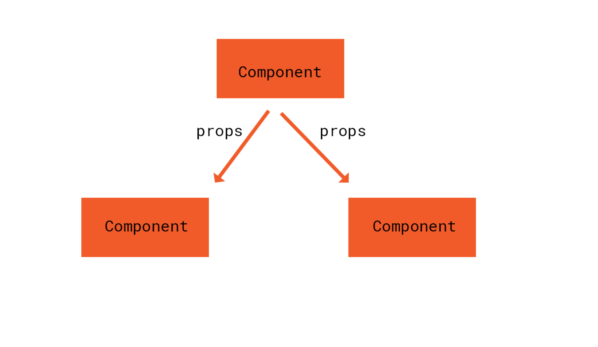
Components pass props to their children

Slide 10
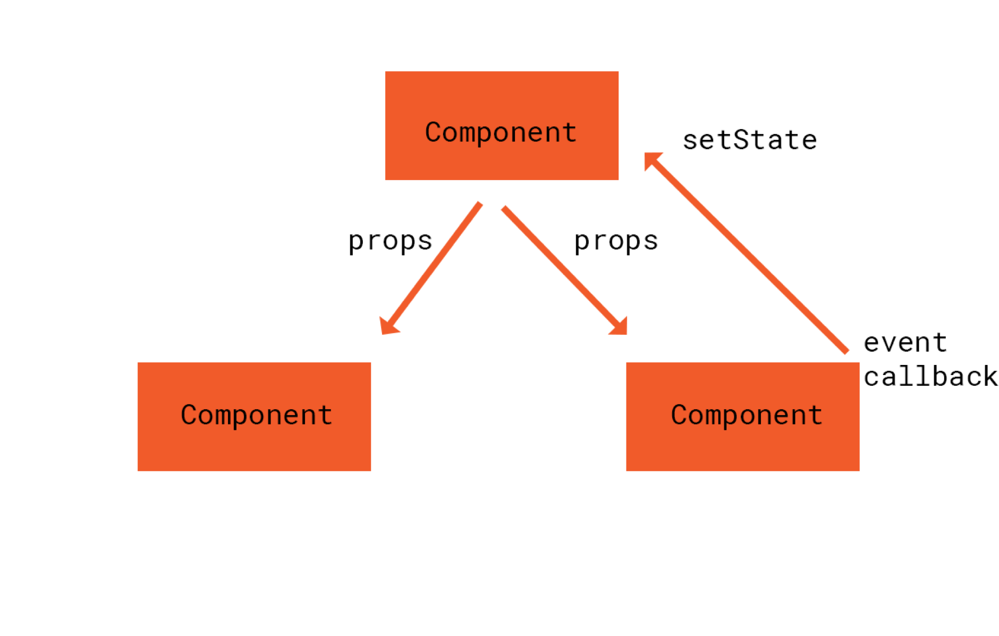
Event callbacks modify the parent’s
state

Slide 11
The new state is passed to the children
as props

Slide 12
Demo
Adding Inverse Data Flow

Slide 13
Demo
Updating State

